Slide 1
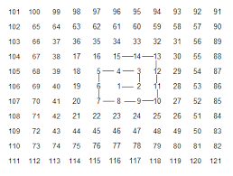

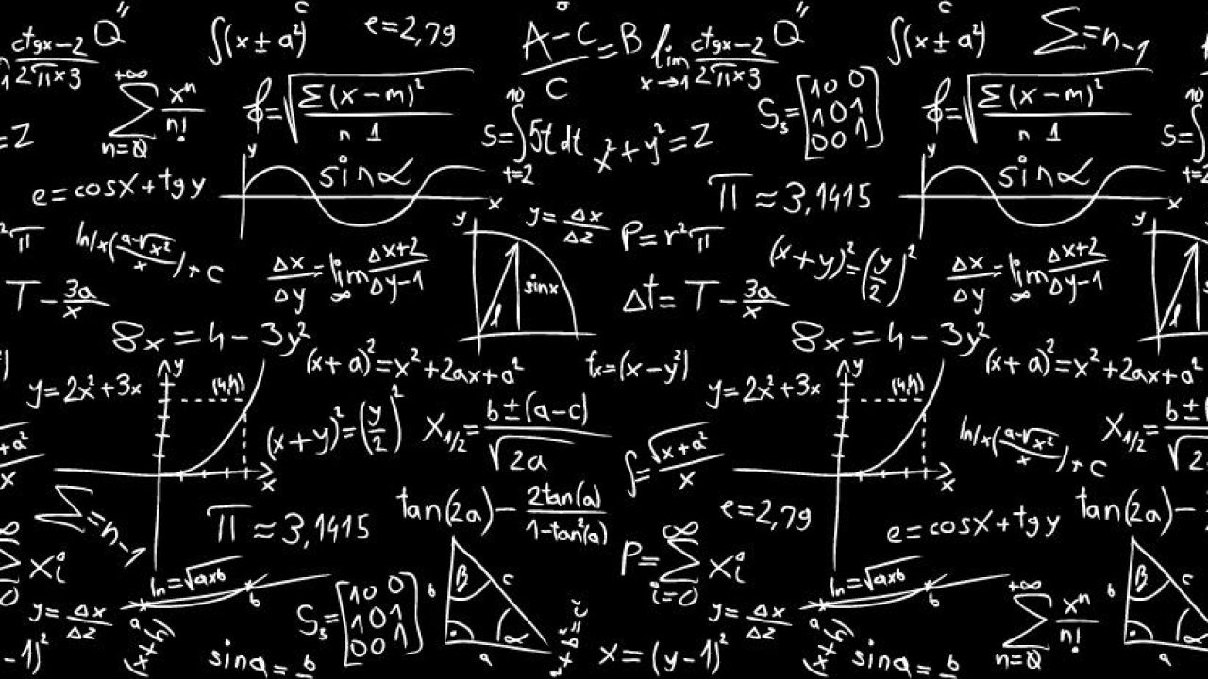

Problemas OmegaUp

Slide 2
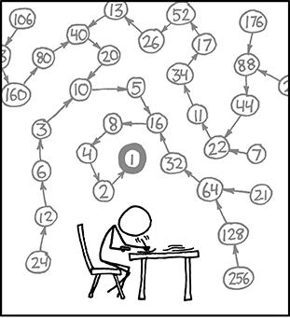
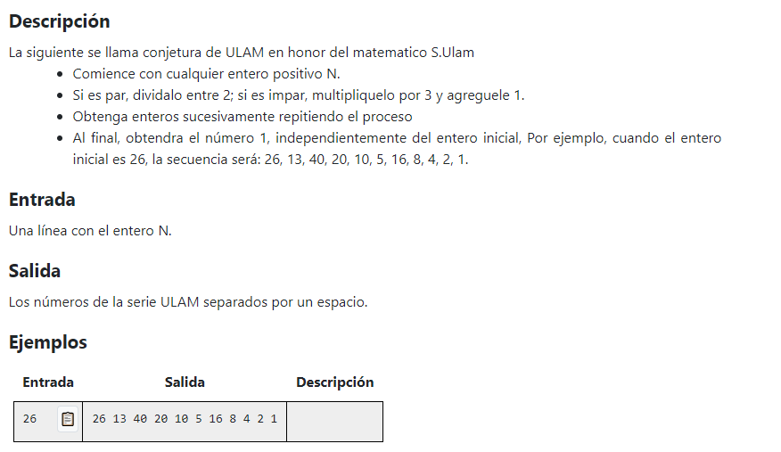
2534. ULAM

Slide 3
Codificación Python
#Resolucion del problema de ULAM
N = int(input())
print(N,end=" ")
while N != 1:
if N % 2 == 0:
N //= 2
else:
N = N * 3 + 1
print(N,end = " ")

Slide 4
Codificación C++
#include <iostream>
using namespace std;
int main() {
int N; cin >> N;
cout << N << " ";
while(N != 1){
if(N % 2 == 0){
N /= 2;
}else{
N = N * 3 + 1;
}
cout << N << " ";
}
return 0;
}

